Slide 1

DETECTION AND CLASSIFICATION OF PERIAPICAL DENTAL X-RAY IMAGES BY APPLYING IMAGE PROCESSING TECHNIQUES NIJANTH SHANKAR K (212219065003) JAYARAJ R (212219065002) NITHISH KUMAR N (212219063003) DEPARTMENT : ECE GUIDE : Dr. S. Dhandapani, M.E, Ph.D

Slide 2
ABSTRACT
Segmentation of Dental X-ray pictures is completed victimization varied image process techniques that are helpful in medical diagnosis clinical functions and time period applications. These ways aim to outline the segmentation of various tooth structures present within the Dental X-ray pictures which can be used for the first detection of decay, tooth fractures, passage treatment and periodontal diseases etc.
Which plays a key role within the identification of diseases. Manual segmentation and classification of Dental X rays pictures for the diagnosing, from the big databases in clinical routine, is extremely advanced and time overwhelming method.
During this paper, we propose a different procedure for the segmentation and classifications of affected tooth, foremost preprocessing is completed employing a thresholding (Otsu’s thresholding) with morphological operations are utilized to separate the affected tooth structures from the Dental X-ray pictures.

Slide 3
INTRODUCTION
Dental experts today are progressively using dental radiographs (computerized X rays) to better recognize and analyze dental diseases. Different types of machines are used by dentists for dental X-ray imaging and hence resolution, contrast, noise, luminance of these images may also be different.
X-ray images are taken by doctors for the particular area where a patient feels discomfort or pain and to diagnose a problem or monitoring a treatment whether it is going in the proper way or not. Situations that may entitle for a dental X-ray include tooth fractures, decay, growth of tooth, root canal treatment, periodontal diseases etc.
Segmentation of dental X-ray images are very useful in various applications namely person recognition or forensic and to help dentists for the medical diagnosis, counting of teeth, estimation of age and so on. Segmentation of different features of tooth is used for different purposes and goals.

Slide 4
As compared to different biometric features, structure and geometry of tooth crown and root remains same for long period of time. In this paper, we are using periapical dental X-ray images which come into the category of intra oral images in which film is placed inside the mouth and dental X ray contains the complete tooth information from crown to the root which is very helpful for the treatment of root canal, interproximal caries and bone loss between the teeth.
Some examples of a dental Periapical X rays as shown in Fig. 1 (a) Teeth (without any problem) (b) Interproximal caries (c) Restoration done and (d) Tooth under root canal treatment. It provides detailed information about the growth of teeth, structure of jaws and soft tissues around the tooth whether any disease occurs or not, which is not visible by human naked eyes.

Slide 5
LITERATURE REVIEW
1. A Novel Approach for Dental Panoramic Radiograph Segmentation Georges Dibeh Alaa Hilal Jamal Charara
In this paper we propose a novel automatic segmentation method that separates maxillary and mandibular jaws with a shape-free model and distinguishes teeth using lines defined within a precise scheme. The developed approaches are implemented and tested over a database of dental panoramic radiographs. Obtained results demonstrate good performance and showed the suitability of the proposed method.

Slide 6
2. GrabCut algorithm for dental X-ray images based on full threshold segmentation Jiafa Mao1, Kaihui Wang1 , Yahong Hu1, Weiguo Sheng2, Qixin Feng3,4
In this paper, a novel segmentation algorithm has been proposed for this purpose. The proposed algorithm is based on full threshold segmentation. We first obtain the outline image set Iwholen and crown image set Icrownm of the complete target tooth. Morphological open operation is then applied to the difference images of Iwholen and Icrownm. Subsequently, the most complete target tooth image and its corresponding crown image are selected. Getting independent target tooth image Icontour and its crown image Icrown from these two images. Median filtering is applied to the synthetic image of Icontour and Icrown, and the resulted image will be used as the Mask for GrabCut to obtain the target tooth image.

Slide 7
3. Quantum Particle Swarm Optimization for Multilevel Thresholding-Based Image Segmentation on Dental X-Ray Images Fahad Parvez Mahdi Syoji Kobashi
In this paper, a quantum computing based computational intelligence technique i.e. quantum particle swarm optimization (QPSO) is introduced for multilevel image thresholding of dental x-ray images. Results demonstrate that the proposed method provides a useful and reliable tool for such multilevel thresholding based image segmentation.

Slide 8
4. Fuzzy Clustering with Level Set Segmentation for Detection of Dental Restoration area Anuj Kumar, H. S. Bhadauria Nitin Kumar
In this paper, we proposed a method to extract the restoration part from the dental X-ray image by combining the Fuzzy clustering with the iterative level set active contour. Here firstly we use the Preprocessing using median filtering to remove the noise present in the X-ray image so that it can be used for further processing. Secondly, we used Fuzzy clustering image segmentation to identify different clusters.

Slide 9
5. Automated Dental Image Analysis by Deep Learning on Small Dataset Jie Yang1, Yuchen Xie1, Lin Liu1, Bin Xia2, Zhanqiang Cao2, and Chuanbin Guo2
In this paper, we present the datasets, procedures, and results conducted to evaluate dental treatment qualities using periapical dental X-ray images taken before and after the operations. In order to support dentists to make clinical decisions, we propose a tool pipeline for automated clinical quality evaluation.We build a dataset with 196 patients’ periapical dental radiography images before and after the treatments. Radiography images are labelled as cases that are ‘getting better’, ‘getting worse’ and ‘have no explicit change’ by designated dental experts.

Slide 10
SCOPE OF THE PROJECT
Dental radiography analysis plays an important role in clinical diagnosis, treatment and surgery as radiographs can be used to find hidden dental structures, malignant or benign masses, bone loss and cavities.

Slide 11
EXISTING SYSTEM
Medical imaging uses to clinical evaluation of the dental anatomy and pathology. Billions of images are performed globally
Imaging processing technique is used for helping accuracy of diagnosis by increasing the image quality
The dental images consider as a simple mixture of (unwanted) background information, diagnostic information, and noise. Aim: This paper is performed to enhance the dental images quality by denoising and detecting the dental structures
This study design is experimental study done on dental images who are preliminarily diagnosed as having different oral diseases and is focused on using the image processing techniques to enhance the image quality of dental x-rays (OPG and Periapical) A convenience sampling was done and dental images were collected and then were treated by using Mat Lab program

Slide 12
PROBLEM STATEMENT
TO DETECTION AND CLASSIFY PERIAPICAL DENTAL X-RAY IMAGES BY APPLYING IMAGE PROCESSING TECHNIQUES

Slide 13
PROPOSED SYSTEM
In this project, we have a tendency to are victimization periapical dental X-ray pictures which get the class of intra oral pictures in which film is placedwithin the mouth and dental X ray contains the entire tooth data from crown to the root that is extremely useful for the treatment of root canal interproximal decay and bone loss between the teeth
It provides careful data about the different stages of the affected teeth, structure of jaws and soft tissues round the tooth whether or not any sickness happens or not that isn't visible by human naked eyes.

Slide 14
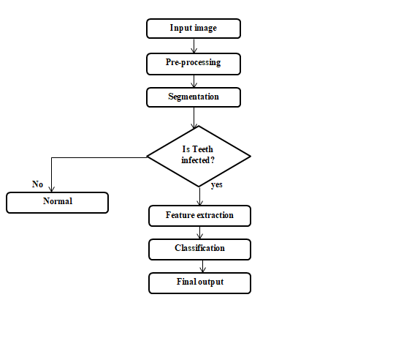
PROPOSED SYSTEM – BLOCK DIAGRAM

Slide 15
PROPOSED SYSTEM CONTD
1. INPUT IMAGE
2. IMAGE PREPROCESSING
3. AFFECTED AREA SEGMENTATION
4. SEGMENTED FEATURE EXTRACTION
5. OUTPUT CLASSIFICATION

Slide 16
MODULE DESCRIPTION
1)INPUT IMAGE:
Read and Display an input Image. Read an image into the workspace, using the imread command or camera. In image processing, it is defined as the action of retrieving an image from some source, usually a hardware-based source for processing. It is the first step in the workflow sequence because, without an image, no processing is possible. The image that is acquired is completely unprocessed.
2) PREPROCESSING:
Pre-processing is a common name for operations with images at the lowest level of abstraction both input and output are intensity images. The aim of pre-processing is an improvement of the image data that suppresses unwanted distortions or enhances some image features important for further processing. Image pre-processing methods use the considerable redundancy in images. Neighboring pixels corresponding to one object in real images have essentially the same or similar brightness value. Thus distorted pixel can often be restored as an average value of neighboring pixels.

Slide 17
A)RESIZING THE INPUT IMAGE:
All the input images are resized into same dimensions. If the specified size does not produce the same aspect ratio as the input image, the output image will be distorted.
B)CONVERTING THE COLOR SPACE:
For many applications of image processing, color information doesn't help us.If you get into the business of attempting to distinguish colors from one another, then one reason for converting RGB image to BLACK AND WHITE or GRAYSCALE formats in image.
3.SEGMENTATION
Image segmentation is a commonly used technique in digital image processing and analysis to partition an image into multiple parts or regions, often based on the characteristics of the pixels in the image. In computer vision, Image Segmentation is the process of subdividing a digital image into multiple segments (sets of pixels, also known as super pixels. Segmentation is a process of grouping together pixels that have similar attributes.

Slide 18
Image Segmentation is the process of partitioning an image into non-intersecting regions such that each region is homogeneous and the union of no two adjacent regions is homogeneous Pixels in a region are similar according to some homogeneity criteria such as color, intensity or texture so as to locate and identify objects and boundaries (lines,curves,etc) in an image. Segmentation accuracy determines the eventual success or failure of computerized analysis procedure.
COLOUR SPACE CONVERSIONS:
Color space conversion is the translation of the representation of a color from one basis to another. This typically occurs in the context of converting an image that is represented in one color space to another color space, the goal being to make the translated image look as similar as possible to the original.
MORPHOLOGICAL OPERATIONS:
Morphological image processing is a collection of non-linear operations related to the shape or morphology of features in an image. Morphology is a broad set of image processing operations that process images based on shapes. Morphological operations apply a structuring element to an input image, creating an output image of the same size.

Slide 19
Some segmentation techniques are,
A) ROI (Region of Interest)
B) K-MEANS CLUSTERING
C) FUZZY C-MEANS
4. FEATURE EXTRACTION
In machine learning, pattern recognition and in image processing, feature extraction starts from an initial set of measured data and builds derived values (features) intended to be informative and non-redundant, facilitating the subsequent learning and generalization steps, and in some cases leading to better human interpretations. Feature extraction is related to dimensionality reduction. When the input data to an algorithm is too large to be processed and it is suspected to be redundant (e.g. the same measurement in both feet and meters, or the repetitiveness of images presented as pixels), then it can be transformed into a reduced set of features (also named a feature vector). Determining a subset of the initial features is called feature selection. The selected features are expected to contain the relevant information from the input data, so that the desired task can be performed by using this reduced representation instead of the complete initial data.

Slide 20
A) SHAPE FEATURES:
Visual features of objects are called the shape characteristics or visual features. For example, circular object or triangular objects or other shapes, perimeter boundary of the object, the diameter of the border and so on. The visual features showed intuitively are all belongs to shape features.
B) GEOMETRICAL FEATURES:
Geometric features are features of objects constructed by a set of geometric elements like points, lines, curves or surfaces. These features can be corner features, edge features, Blobs, Ridges, salient point’s image texture and so on, which can be detected by feature detection methods.
C) TEXTURE FEATURES:
An image texture is a set of metrics calculated in image processing designed to quantify the perceived texture of an image .Image Texture gives us information about the spatial arrangement of color or intensities in an image or selected region of an image.
Some feature extraction methods are,
A) GLCM (Grey level co-occurrence matrix)

Slide 21
5. CLASSIFICATION:
Image classification refers to the task of extracting information classes from a multiband raster image. The resulting raster from image classification can be used to create thematic maps. The recommended way to perform classification and multivariate analysis is through the Image Classification toolbar. There are many classification algorithms are available and some classification algorithm that are given below,
A) SVM (SUPPORT VECTOR MACHINE CLASSIFICATION)

Slide 22
ADVANTAGES:
The thresholding technique is best suitable for accurate segmentation when compared to k-means clustering technique.
Here detection and classification both are done.
Because the stage is more important factor for doctor references leads to reduces the test process.

Slide 23
APPLICATIONS:
Segmentation of dental X-ray images are very useful in various applications namely person recognition or forensic and to help dentists for the medical diagnosis, counting of teeth, estimation of age and so on.
Segmentation of different features of tooth is used for different purposes and goals.
To support early detection, diagnosis and optimal treatment.
Image segmentation plays an essential role in many medical applications.
Low SNR conditions and various artifacts makes its automation challenging.
To achieve robust and accurate segmentation.

Slide 24
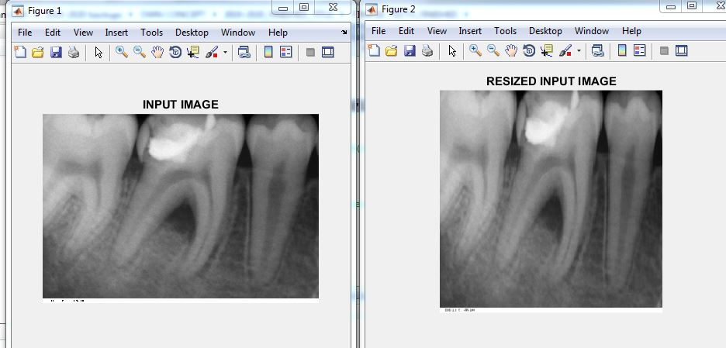
RESULT
FOR AFFECTED TEETH:
INPUT & RESIZED IMAGES:

Slide 25
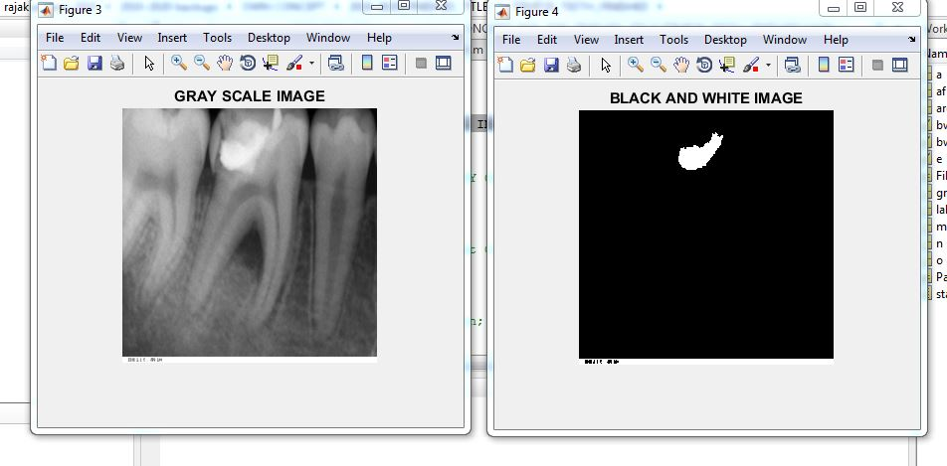
2. GRAY SCALE & BLACK AND WHITE IMAGE:

Slide 26
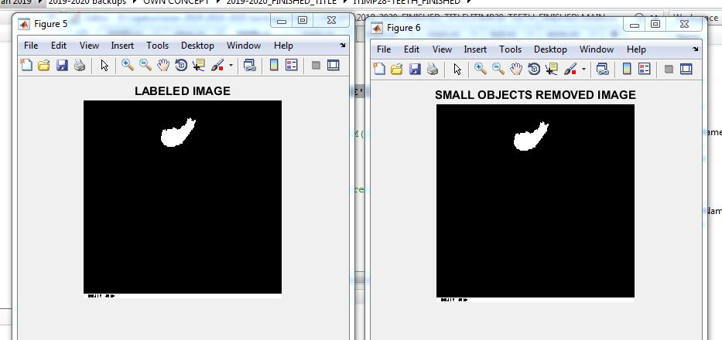
3 .LABELED IMAGE AND SMALL OBJECTS REMOVED IMAGE:

Slide 27
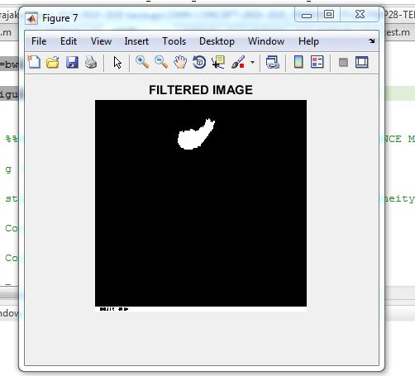
4. SEGMENTED IMAGE:

Slide 28
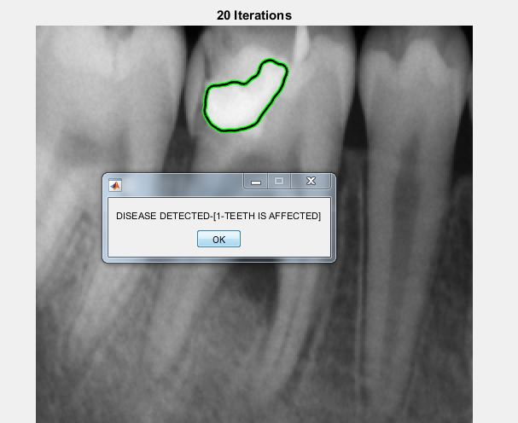
5. FINAL OUTPUT IMAGE:

Slide 29
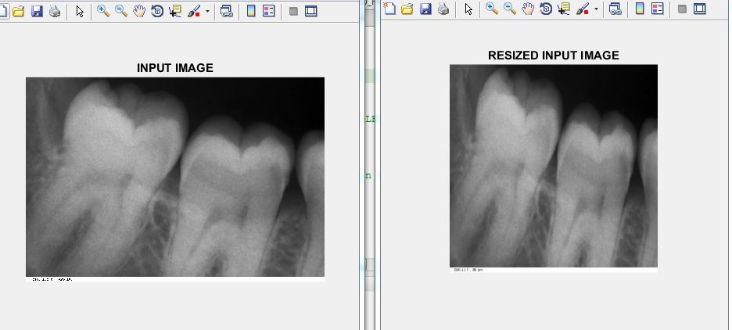
FOR NORMAL TEETH:
INPUT & RESIZED IMAGES:

Slide 30
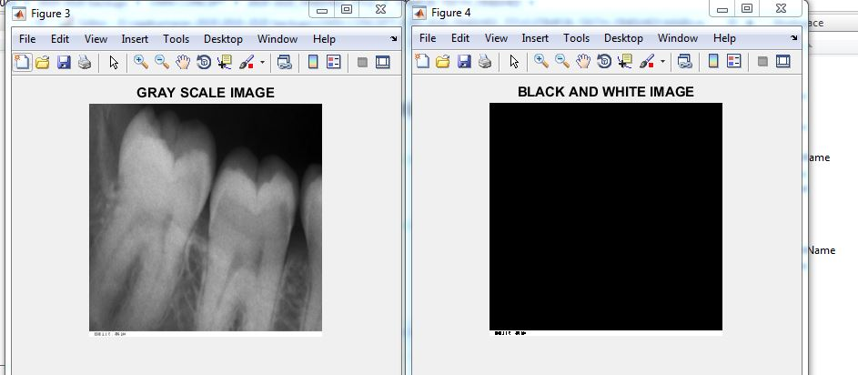
2. GRAY SCALE & BLACK AND WHITE IMAGE:

Slide 31
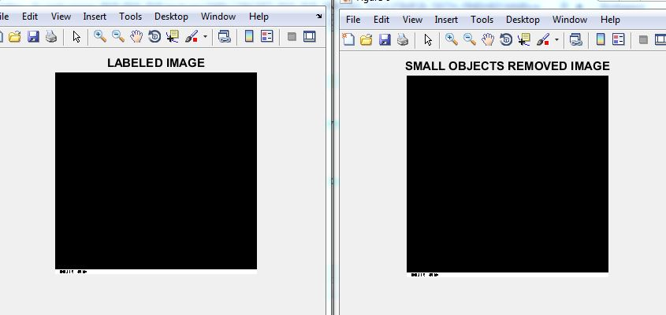
3 .LABELED IMAGE AND SMALL OBJECTS REMOVED IMAGE:

Slide 32
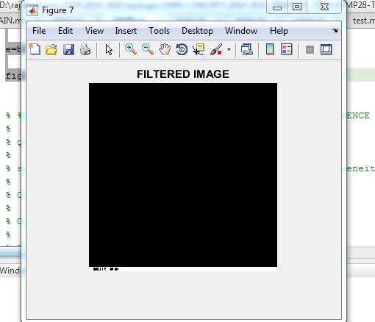
4. SEGMENTED IMAGE:

Slide 33
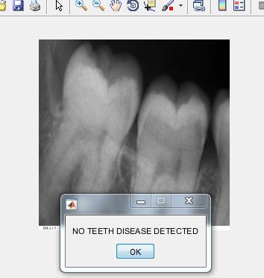
5. FINAL OUTPUT IMAGE:

Slide 34
CONCLUSION AND FUTURE WORK
In this project, we propose an automatic method for the segmentation of dental X-ray images of teeth for the diagnosis of anomalies based on the shape of the segmented teeth. In the experimental results, background and bones parts are distinguished very efficiently
The proposed method is also beneficial for person identification by matching teeth shape
The experimental results identified in this paper will positively helpful to the doctors and Forensic odontologist in automated dental identification system. In future work, classification approach may be implemented to find the canine, incisor, molars and premolars teeth.

Slide 35
REFERENCES
[1] O. E. Langland, R. P. Langlais, J. W. Preece, “Principles of Dental Imaging” Lippincott Williams & Wilkins, Philadelphia, USA, 201–298, 2002
[2] E. Said, G. F. Fahmy, D. Nassar, H. Ammar, “Dental x-ray image segmentation, defense and security” Int. Soc. Opt. Photonics, 409–417, 2004.
[3] A. K. Jain, H. Chen, “Matching of dental X-ray images for human identification. Pattern Recognit” 37 (7), 1519–1532, 2004.
[4] P. L. Lin, Y. H. Lai, P. W. Huang, “An effective classification and numbering system for dental bitewing radiographs using teeth region and contour information,” Pattern Recognition 43(4):1380–1392, 2010.
[5] E. H. Said, E. M. Diaa, G. F. Nassar, H. H. Ammar, “Teeth segmentation in digitized dental X-ray films using mathematical morphology,” IEEE Transactions on Information Forensics and Security 1(2): 178–189,2006.

Slide 36
[6] O. Nomir, M. Abdel-Mottaleb, “Fusion of matching algorithms for human identification using dental X-ray radiographs,” IEEE Transactions on Information Forensics and Security, vol. 3, no. 2, June 2008.
[7] F. Aeini, F. Mahmoudi, “Classification and numbering of posterior teeth in bitewing dental images,” 3rd International Conference on Advanced Computer Theory and Engineering (ICACTE), 2010.
[8] J. Zhou and M. Abdel-Mottaleb, "A contentbased system for human identification based on bitewing dental X-ray images," Pattern Recognition, Vol. 38, pp. 2132-2142, 2005.
[9] P. Lira, G. A. Giraldi, L. Neves, and R. Feijoo,“Dental R-Ray Image Segmentation Using Texture Recognition,” Latin America Transactions, IEEE (Revista IEEE America Latina), Vol. 12, No. 4, 2014.
[10] N. Patanachai, N. Covavisaruch and C. Sinthanayothin, “Wavelet transformation for dental Xray radiographs segmentation technique”, 8th International Conference on ICT and Knowledge Engineering, IEEE, PP, 103 – 106, 2010.

Slide 37
[11] A. E. Rad, M. Rahim, M. Shafry, A. Rehman, A. Altameem, and T. Saba, “Evaluation of Current Dental Radiographs Segmentation Approaches in Computeraided Applications”, Institution of Electronics and Telecommunication Engineers Technical Review, (Medknow Publications & Media Pvt. Ltd.) , Vol. 30, No. 3, PP. 210 – 222, 2013.
[12] S. J. Nelson and M. M. Ash, “Wheeler‟s Dental Anatomy, Physiology, and Occlusion”, 9th Ed, Missouri, US, Saunders Elsevier, 2010.
[13] P. L. Lin, Y.H. Lai, “Effective segmentation for dental X-ray images using texture-based fuzzy inference system” Advanced Concepts for Intelligent Visions System LNCS 5259 , 936–947, 2008.
[14] H. Hassanpour, N. Samadiani and S. M. Salehi, “Using morphological transforms to enhance the contrast of medical images” The Egyptian Journal of Radiology and Nuclear Medicine, 46(2), pp.481-489, 2015.

Slide 38
[19] Y.D. Ma, L. Li, Y.F. Wang, et al., Principle of Pulse-coupled Neural Network andits Applications, Science Press, Beijing, China, 2006, pp. 1–20.
[20] R. Eckhorn, H.J. Reitboeck, M. Arndt, Feature linking via synchronizationamong distributed assemblies: simulations of results from cat visual cortex,Neural Comput. 2 (3) (1990) 293–307.
[21] J. Kennedy, R. Eberhart, Particle swarm optimization, in: IEEE InternationalConference on Neural Networks, Perth, WA, IEEE, Piscataway, USA, 1995, pp.1942–1948.
[22] J. Sun, B. Feng, W.B. Xu, Particle swarm optimization with particles havingquantum behavior, in: Congress on Evolutionary Computation, Portland, USA,IEEE, Piscataway, USA, 2004, pp. 326–331.
[23] Y.D. Ma, R.L. Dai, L. Li, Automated image segmentation using pulse coupledneural networks and images entropy, J. China Inst. Commun. 23 (1) (2002)46–51.
[24] Y. Li, X.J. Wu, A novel image fusion method using self-adaptive dual-channelpulse coupled neural networks based on PSO evolutionary learning, ActaElectron. Sinica 42 (2) (2014) 217–222.
[25] Y.D. Ma, K. Zhan, Z.B. Wang, Image Fusion Applications of Pulse-CoupledNeural Network, 2010, pp. 83–109.
[26] M. Seetha, I.V. MuraliKrishna, B.L. Deekshatulu, Data fusion performanceanalysis based on conventional and wavelet transform techniques, in: IEEEProceedings on Geoscience and Remote Sensing Symposium, vol. 4, 2005, pp.2842–2845.

Slide 39
[27] Y. Zhao, Q. Zhao, A. Hao, Multimodal medical image fusion using improvedmulti-channel PCNN, Bio-medical Mater. Eng. 24 (1) (2014) 221–228.
[28] Z. Wang, A.C. Bovik, H.R. Sheikh, et al., Image quality assessment: from errorvisibility to structural similarity, IEEE Trans. Image Process. 13 (4) (2004)600–612.
[29] Z.B. Wang, Y.D. Ma, J. Gu, Multi-focus image fusion using PCNN, PatternRecognit. 43 (6) (2010) 2003–2016.
[30] P.J. Burt, E.H. Adelson, The Laplacian pyramid as a compact image code, IEEETrans. Commun. COM-31 (4) (1983) 532–540.
[31] G.Y. Wang, X.Z. Xu, X.Y. Jiang, R. Nie, A modified model of pulse coupledneural networks with adaptive parameters and its application on imagefusion, ICIC Express Lett. 6 (9) (2015) 2523–2530.

Slide 40
LIST OF PUBLICATIONS/PATENTS
S. Dhandapani, R. Jennie Bharathi, K. Nijanth Shankar, R. Jayaraj and N. Nithish Kumar, "Analysis of Dental X-Ray Images for the Diagnosis and Classification of Oral Conditions "7th International Conference on Computing Methodologies and Communication (ICCMC 2023) organized by Surya Engineering College”, Erode, Tamil Nadu, India, 2023.
S. Dhandapani, J. Jeffin Gracewell, K. Nijanth Shankar, R. Jayaraj and N. Nithish Kumar, "Analyzing dental X-ray images to diagnose and categorise oral conditions” 7 TH International Conference on Inventive Communication Technologies(ICICCT – 2023),Nammakal,INDIA.

Slide 41
PROJECT DEMO VIDEO

